Slide 1

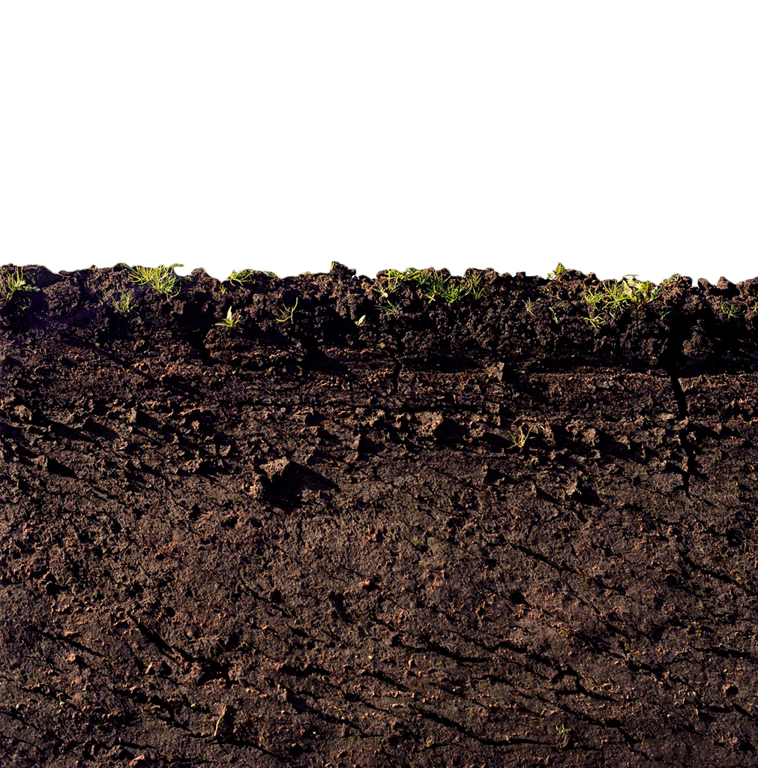

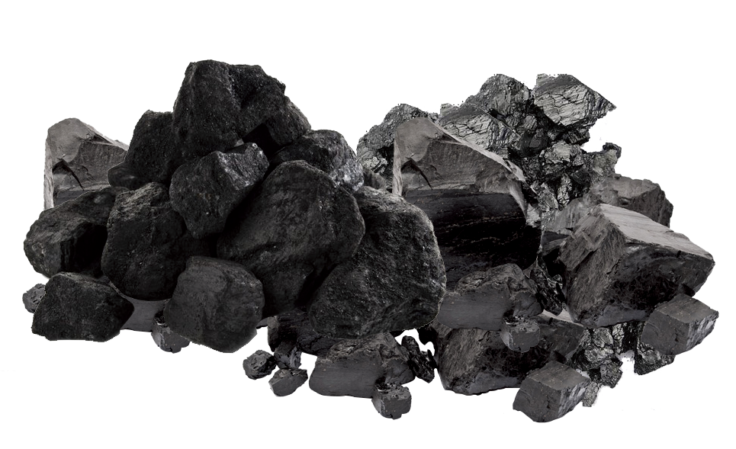

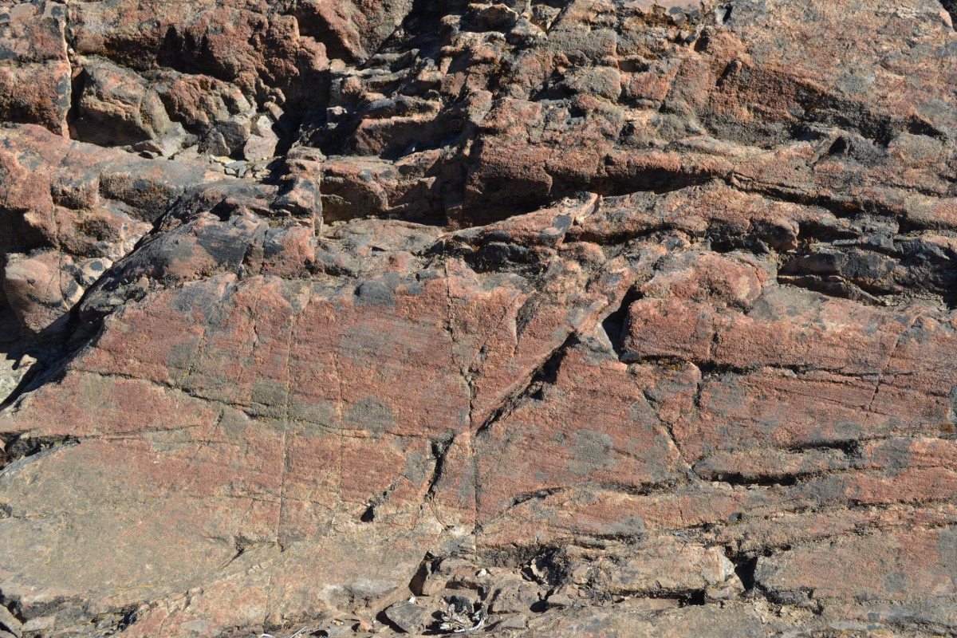
MYCROFOREST
A microworld to teach about challenges around economically viable, climate aware forest management.
You’re gifted a forest.
What can you do?
What should you do?

Slide 2
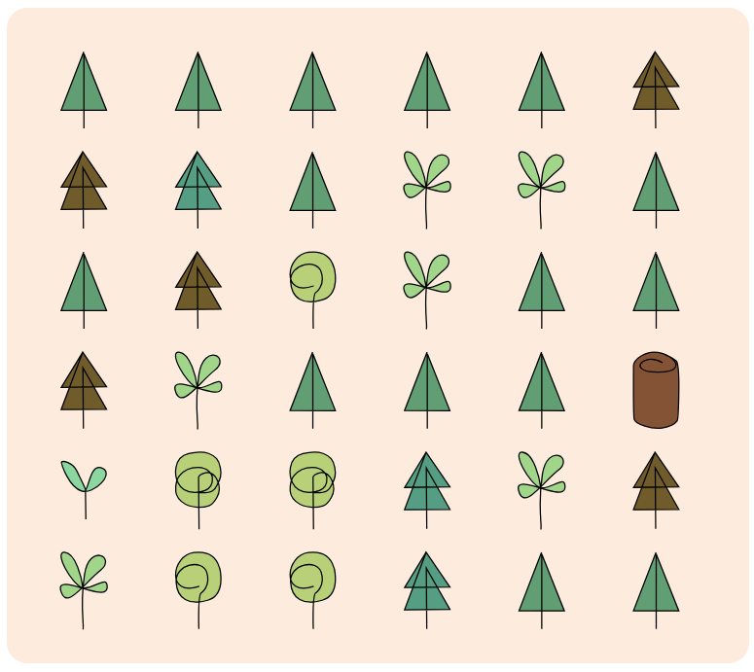
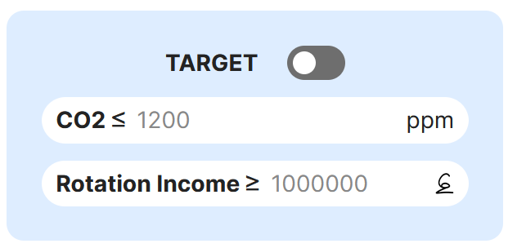
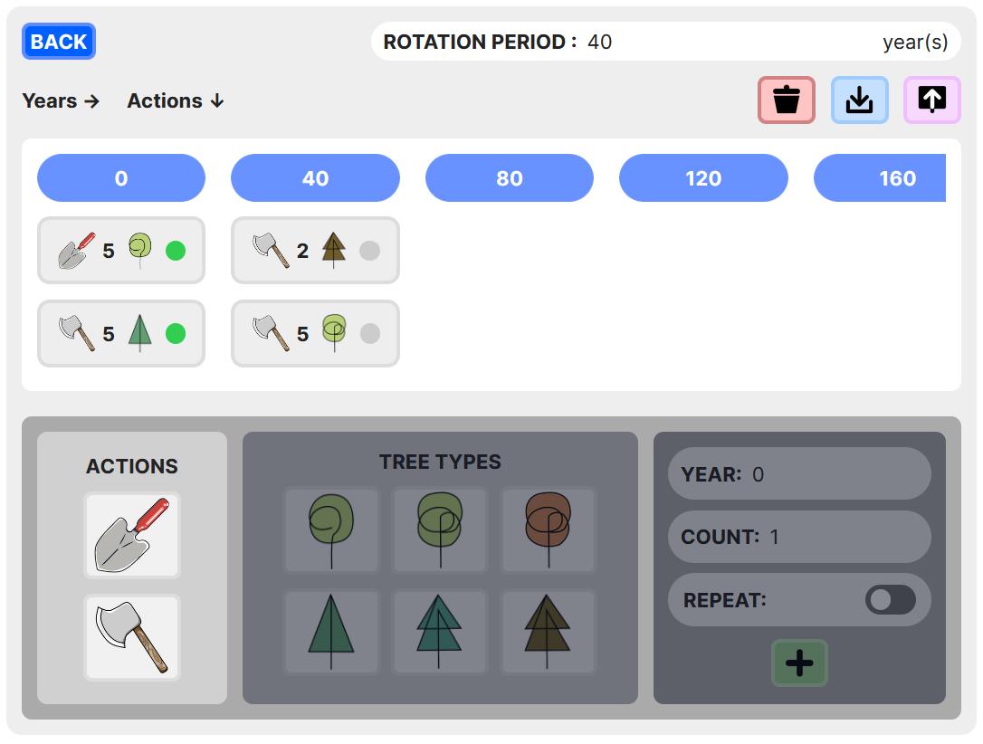
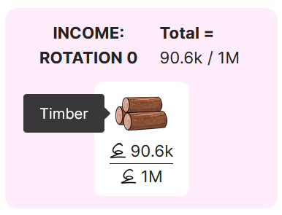
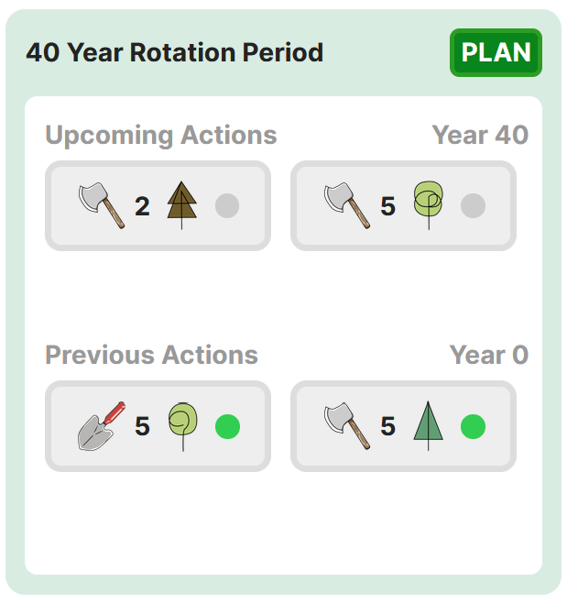

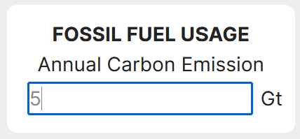
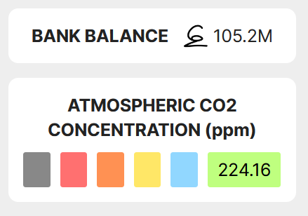
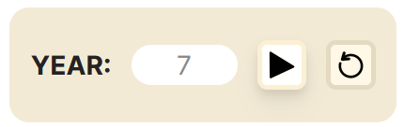
2. Set target atmospheric CO2 and/or income targets.
4. Felling trees fetches income from timber sold for use as lumber and to burn for energy.
1. Get your personal forest with 2 types of trees at different stages in their life.
3. Play around with frequency and timing of planting/felling trees.
Take on suggested challenges.
5. Play to see the forest grow over 300 years. View your plans in action and its impact on CO2 in the air in addition to your bank balance.
Experiment on your own.
6. Introduce CO2 emissions due to burning of fossil fuels. Observe effects.
Save and share your plan with others.

Slide 3






UP FOR A CHALLENGE?
For good, steady income, chop a few mature trees frequently. Leave rest to grow. Chop bigger, older trees whenever possible. Plant profitable species in place of cut trees to turn the forest into a plantation.
Not chopping down any trees is the best strategy for maximum C sequestration. Nonetheless, it is still possible to chop few trees and make some money while keeping CO2 relatively low.
Earning from timber alone gets harder as CO2 emissions from fossil fuels increase if CO2 levels are to be kept reasonable. No magic pill. Emissions must be reduced to slow down global warming & climate change.
?
?
?
Make as much money as possible. Set as high a minimum income target as possible and try to hit it every rotation.
Do that while trying to keep CO2 levels as low as possible. How low of an atmospheric CO2 target can you set and meet? Maximize income and minimize CO2 in the air.
Add emissions due to burning of fossil fuels. What happens? How high can emissions be before the forest fails to keep CO2 levels below the orange, and then red zone?

Slide 4
UP FOR A CHALLENGE?
1
2
3
Make as much money as possible. Set as high a minimum income target as possible and try to hit it every rotation.
Do that while trying to keep CO2 levels as low as possible. How low of an atmospheric CO2 target can you set and meet? Maximize income and minimize CO2 in the air.
Add emissions due to burning of fossil fuels. What happens? How high can emissions be before the forest fails to keep CO2 levels below the orange, and then red zone?
CHALLENGE
For good, steady income, chop a few mature trees frequently. Leave rest to grow. Chop bigger, older trees whenever possible. Plant profitable species in place of cut trees to turn the forest into a plantation.
Not chopping down any trees is the best strategy for maximum C sequestration. Nonetheless, it is still possible to chop few trees and make some money while keeping CO2 relatively low.
Earning from timber alone gets harder as CO2 emissions from fossil fuels increase if CO2 levels are to be kept reasonable. No magic pill. Emissions must be reduced to slow down global warming & climate change.
POSSIBLE SOLUTION

Slide 5
THE 2-HR PLAN
BY MONDAY
CONCERNS
Intro: 5 mins
Learning + Help: 25 mins
Challenge 1: 40 mins
Challenge 2: 15 mins
Challenge 3: 15 mins
Presentation: 15 mins
Survey: 5 mins
App Deployed
User Guide Updated
Video Guide
Evaluation of observed behavior.
CO2 levels != real world.
Observed behaviour = real world?
Observed best strategies = real-world best strategies?
Can challenges be completed in time?
Is this tool engaging?

